Slide 1
Big Mountain Ski Resort
A Data-Driven Approach to Strategic Pricing Optimization

Slide 2
Problem Framing
Big Mountain Ski Resort is looking to restructure its pricing strategy
The resort currently charges a premium above the average price point of other resorts in the market.
This is problematic because…
Data is not leveraged to benchmark its features against competitors and set prices accordingly.
A price based off of the market could lead to undercharging.
The addition of a chair lift has raised the operational costs of the resort. Failure to analyze pricing structures could result in profit loss.

Slide 3
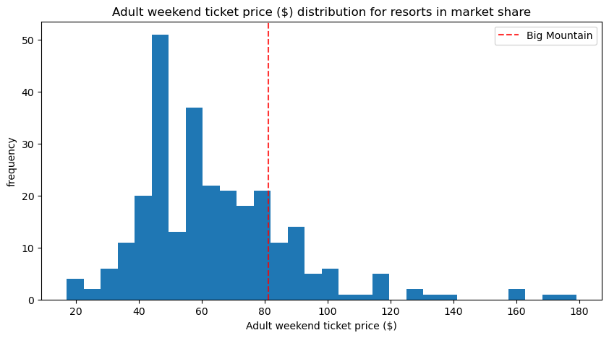
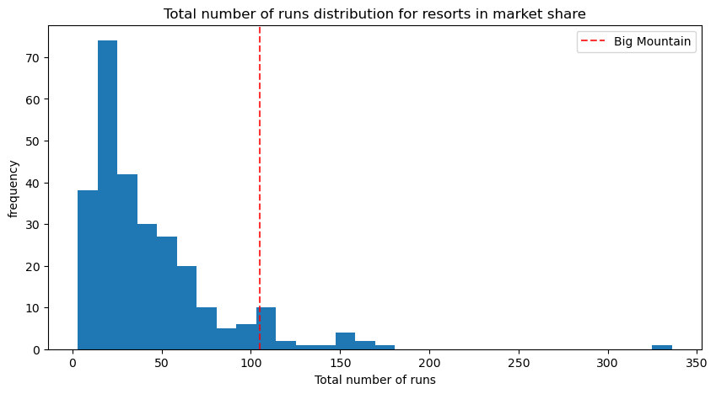
Key Findings & Recommendations
Findings
Big Mountain Resort is a leader in desirable features compared to the other resorts.
Current Adult Weekend ticket prices can be raised from $81.00 up to $95.87
Recommendations
Adding a run to increase the vertical drop by 150 ft and installing an additional chair lift will support Adult Weekend ticket prices to increase by $1.99
This could amount to $3,474,638 over the season.

Slide 4
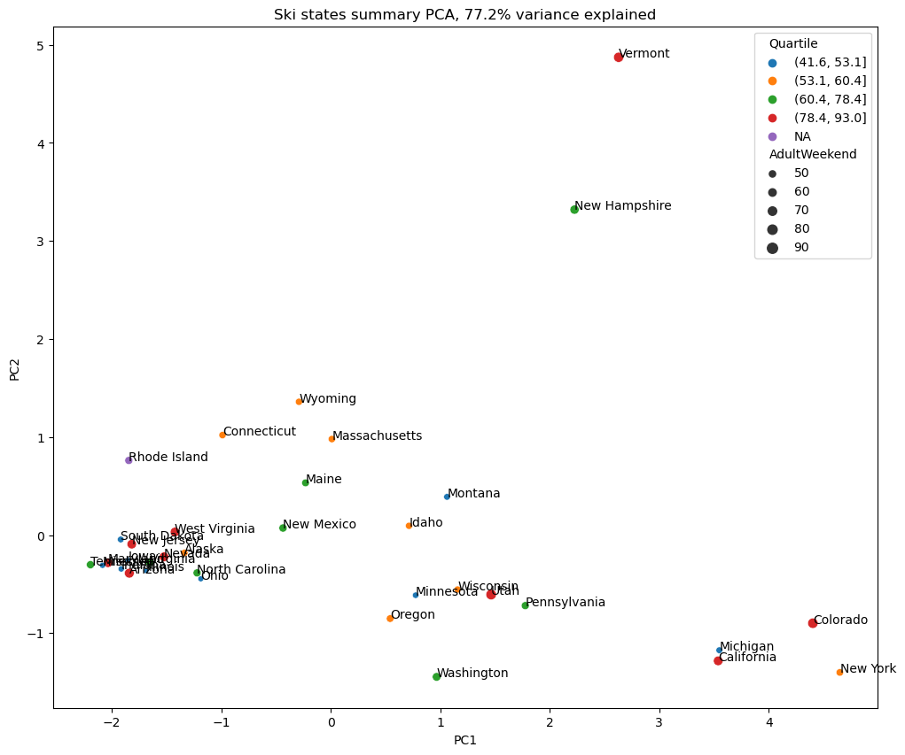
Analysis
State data was added to the ski resort data as a way generate a deeper understanding of how resorts charged based on population and number of resorts per state.
PCA was used to identify variance among states
Montana resides in the lower quartile for ticket prices

Slide 5
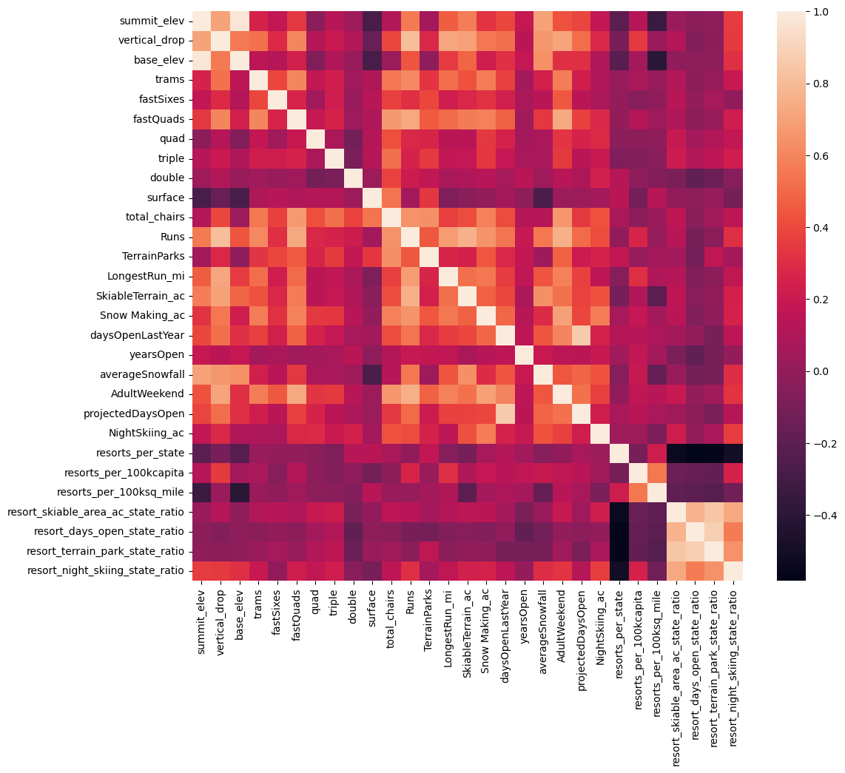
Analysis Cont.
A heat map was implemented to identify correlations among features.
Adult Weekend was highly correlated with:
Fast quads
Number of runs
Snow making

Slide 6
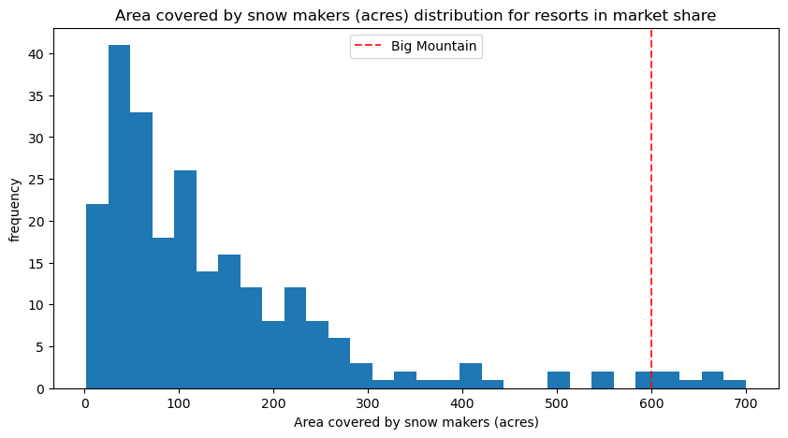
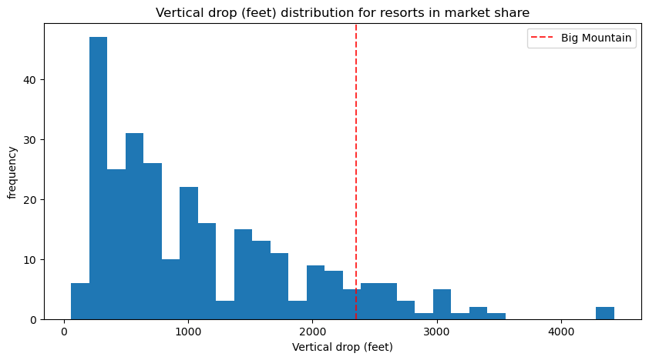
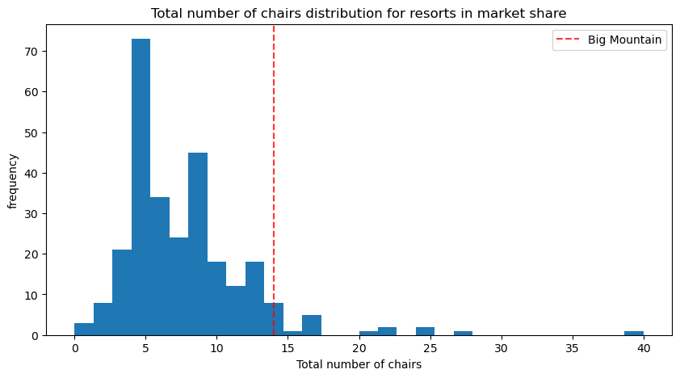
Modeling
A model was built to create an optimal price point for Big Mountain’s Adult Weekend tickets.
The model was trained to learn how the top features for Big Mountain compared to the rest of the resorts.
Four different scenarios were ran as options for price optimization

Slide 7
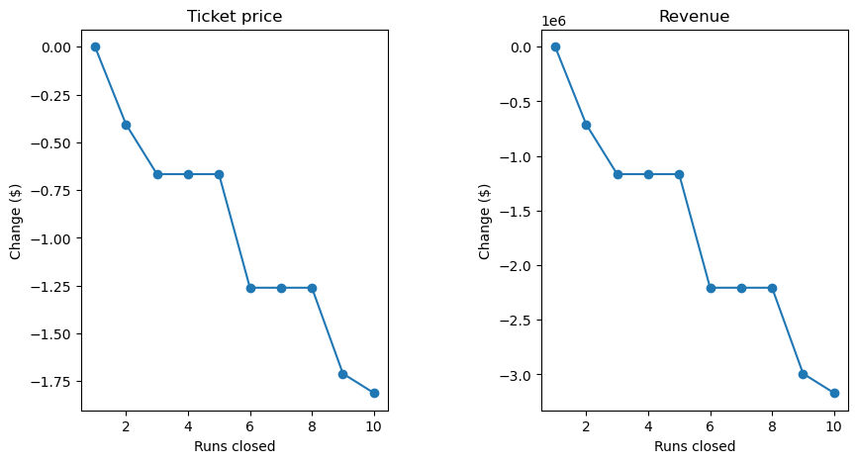
Modeling Cont.
Scenario 1
Closing up to ten of the least used runs can decrease operational costs but will warrant a decrease in ticket price. Closing 1-5 runs will result in the least drastic response to dropped ticket rates and revenue.
Scenario 2
Adding a run to increase the vertical drop by 150 ft and installing an additional chair lift will support increasing the rate of Adult Weekend ticket prices by $1.99 which could amount to $3,474,638 over the season.
Scenario 3
Similar to Scenario 2, this scenario calls for adding a run to increase the vertical drop by 150 ft, installing an additional chair lift, and adding 2 acres of snow making coverage. This scenario supports Adult Weekend ticket prices to increase by $1.99 and could amount to $3,474,638 over the season.
Scenario 4
Increase the longest run by 0.2 miles and guarantee snow coverage by adding 4 acres of snow making. This scenario does not support increasing or decreasing ticket prices.

Slide 8
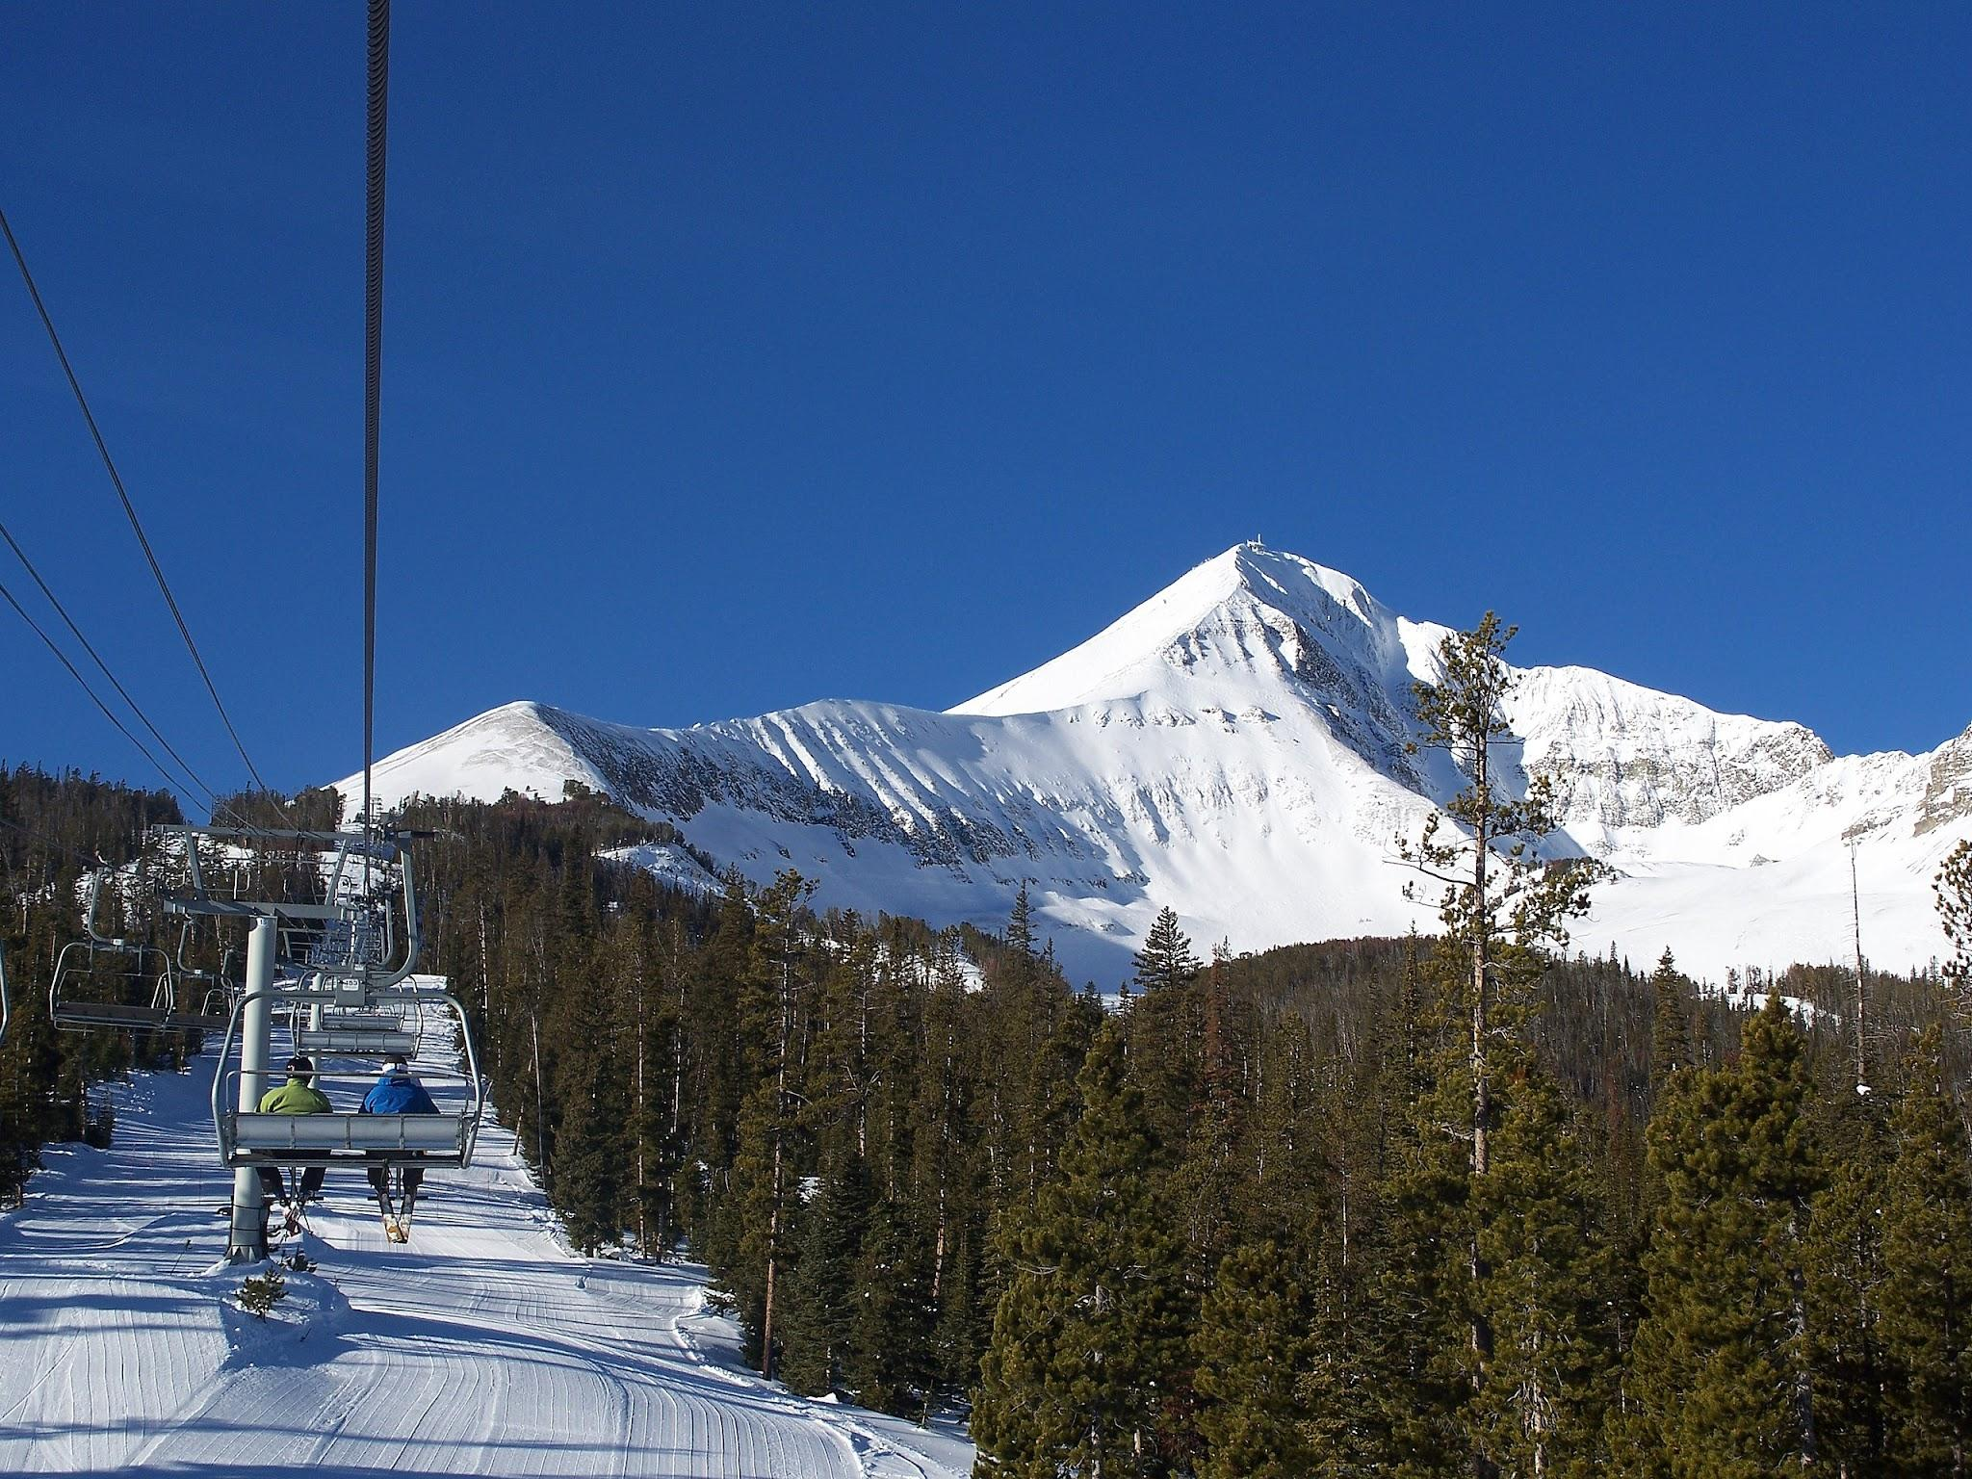
Summary & Conclusion
Given Big Mountain's top features we recommend the implementation of Scenario 3. Not only would adding an additional run heighten the resort's appeal, but this scenario also supports an increase in ticket price, and could yield high profits.
Scenario 3 would require a $1.99 dollar increase in Adult Weekend ticket prices; however, per the model’s recommendation, the resort could theoretically surpass the estimated amount of $3,474,638 by increasing prices by an additional $10.39- $14.87.

